Slide 1
Combinational Logic Design with VHDL

Slide 2
Lecture Roadmap
Basic Logic Review
  Basic Gates (AND,OR,XOR,NAND,NOR)
  DeMorgan’s Law
Combinational Logic Blocks
  Multiplexers
  Decoders, Demultiplexers
  Encoders, Priority Encoders
  Half Adders, Full Adders
Multi-Bit Combinational Logic Blocks
  Multi-bit multiplexers
  Multi-bit adders
  Comparators

Slide 3
Basic Logic Review

Slide 4
Digital Logic
Digital logic gates implement Boolean functions
  1 represents true
  0 represent false
Two types of logic
  Combinational logic: output depends on the input
  Sequential logic: output depends on the input and previous outputs and/or inputs

Slide 5
Basic Concepts
Simple logic gates
  AND → 0 if one or more inputs is 0
  OR → 1 if one or more inputs is 1
  NOT
  NAND = AND + NOT
    1 if one or more inputs is 0
  NOR = OR + NOT
    0 if one or more input is 1
  XOR implements exclusive-OR function
NAND and NOR gates require fewer transistors than AND and OR in standard CMOS
Functionality can be expressed by a truth table
  A truth table lists output for each possible input combination

Slide 6
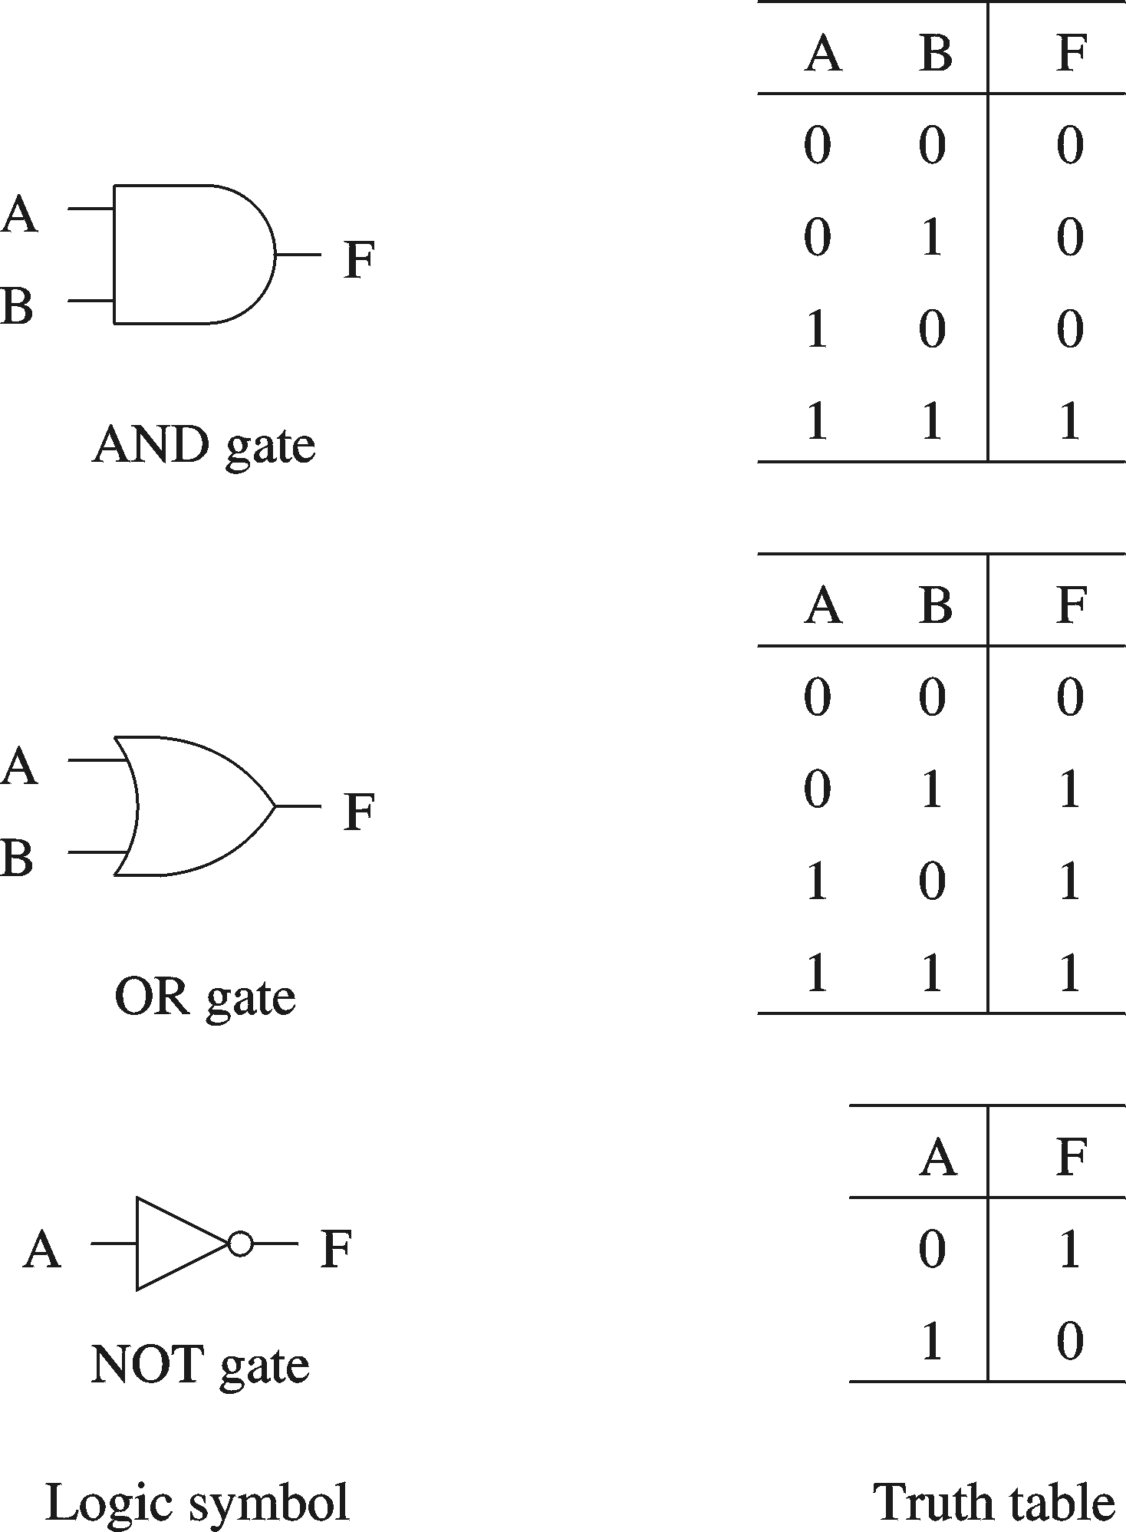
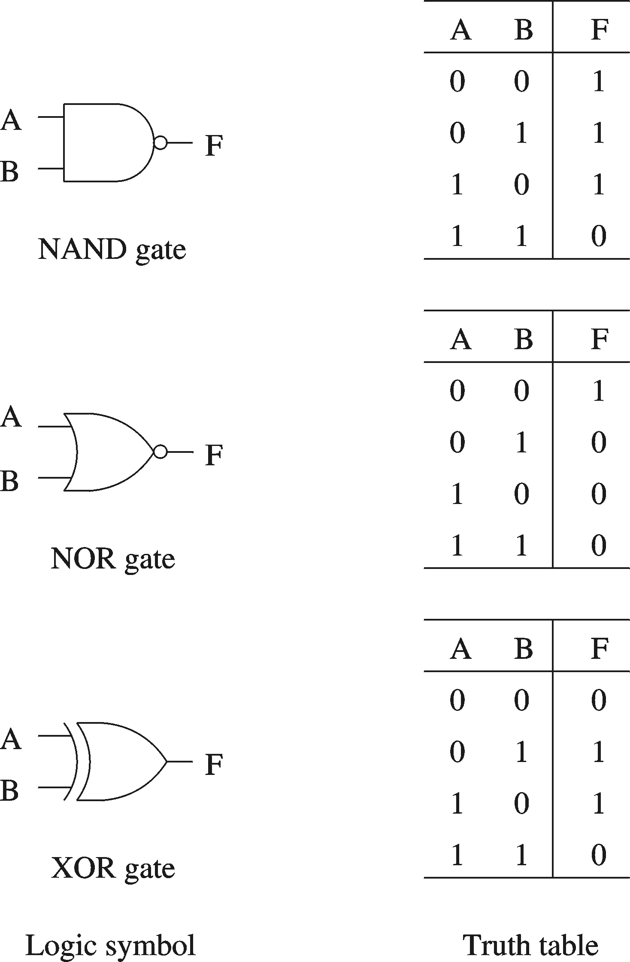
Basic Logic Gates

Slide 7
Number of Functions
Number of functions
  With N logical variables, we can define
  2^{2N} functions
  Some of them are useful
    AND, NAND, NOR, XOR, …
  Some are not useful:
    Output is always 1
    Output is always 0
  “Number of functions” definition is useful in proving completeness property

Slide 8
Complete Set of Gates
Complete sets
  A set of gates is complete
    if we can implement any logical function using only the type of gates in the set
  Some example complete sets
    {AND, OR, NOT} Not a minimal complete set
    {AND, NOT}
    {OR, NOT}
    {NAND}
    {NOR}
  Minimal complete set
    A complete set with no redundant elements.

Slide 9
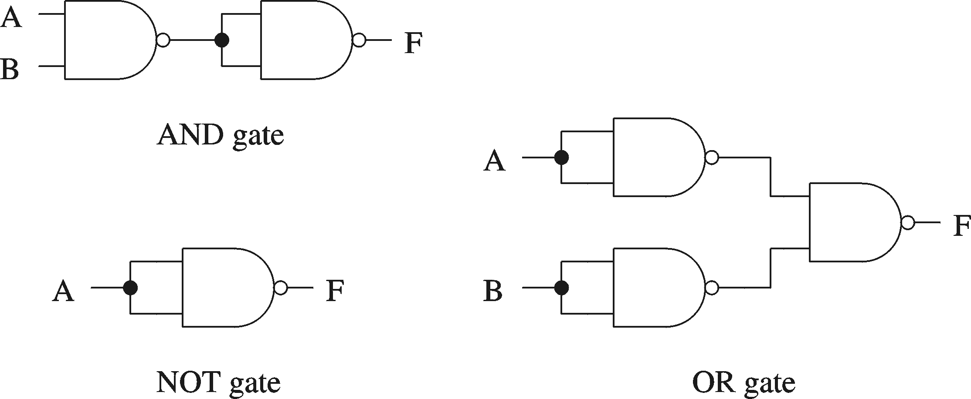
NAND as a Complete Set
Proving NAND gate is universal

Slide 10
Logic Functions
Logical functions can be expressed in several ways:
  Truth table
  Logical expressions
  Graphical form
  HDL code
Example:
  Majority function
    Output is one whenever majority of inputs is 1
    We use 3-input majority function

Slide 11
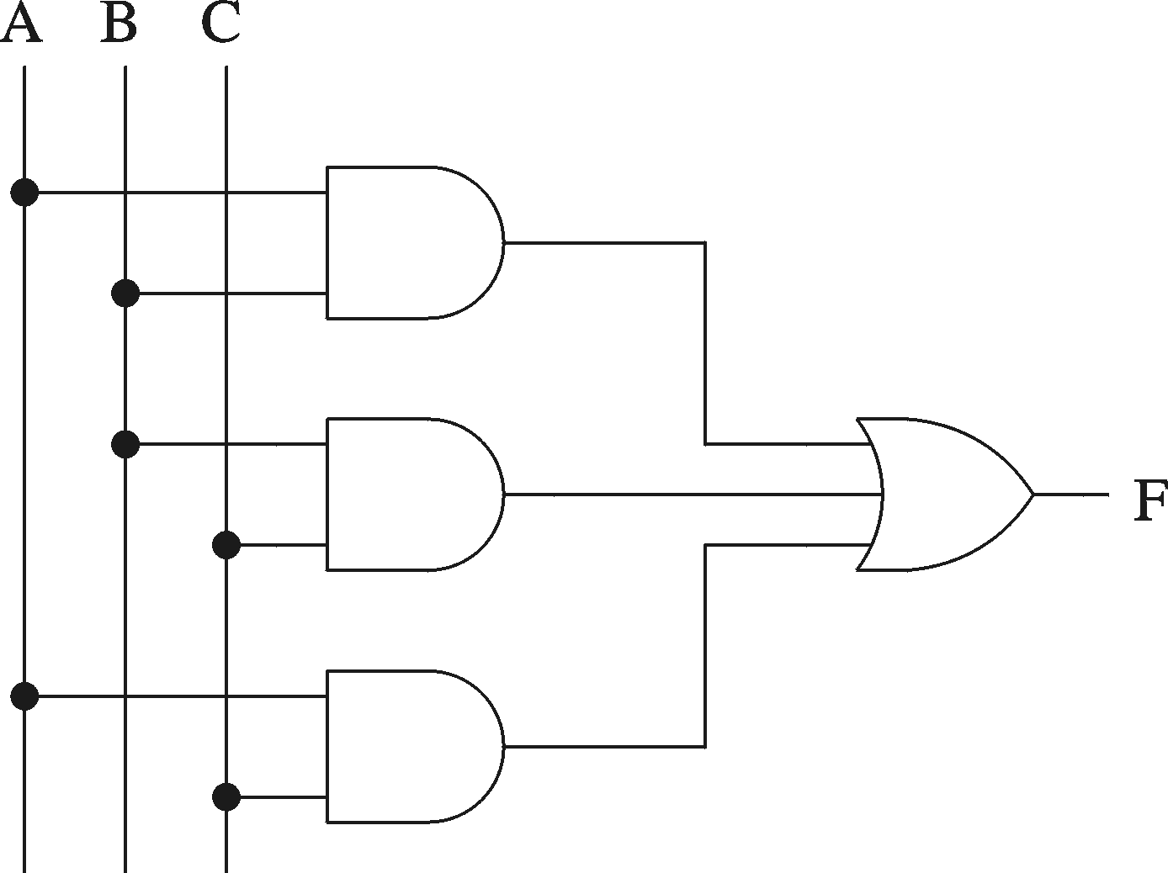
Logic Functions (cont’d)
Truth table
A B C F
0 0 0 0
0 0 1 0
0 1 0 0
0 1 1 1
1 0 0 0
1 0 1 1
1 1 0 1
1 1 1 1
Logical expression form
F = A B + B C + A C
Graphical schematic form

Slide 12
Boolean Algebra
Boolean identities
Name AND version OR version
Identity x.1 = x x + 0 = x
Complement x. x’ = 0 x + x’ = 1
Commutative x.y = y.x x + y = y + x
Distribution x. (y+z) = xy+xz x + (y. z) =
(x+y) (x+z)
Idempotent x.x = x x + x = x
Null x.0 = 0 x + 1 = 1

Slide 13
Boolean Algebra (cont’d)
Boolean identities (cont’d)
Name AND version OR version
Involution x = (x’)’ ---
Absorption x. (x+y) = x x + (x.y) = x
Associative x.(y. z) = (x. y).z x + (y + z) =
(x + y) + z
de Morgan (x. y)’ = x’ + y’ (x + y)’ = x’ . y’
(de Morgan’s law in particular is very useful)

Slide 14
Majority Function Using Other Gates
Using NAND gates
  Get an equivalent expression
        A B + C D = (A B + C D)’’
  Using de Morgan’s law
        A B + C D = ( (A B)’ . (C D)’)’
  Can be generalized
    Example: Majority function
        A B + B C + AC = ((A B)’ . (B C)’ . (AC)’)’

Slide 15
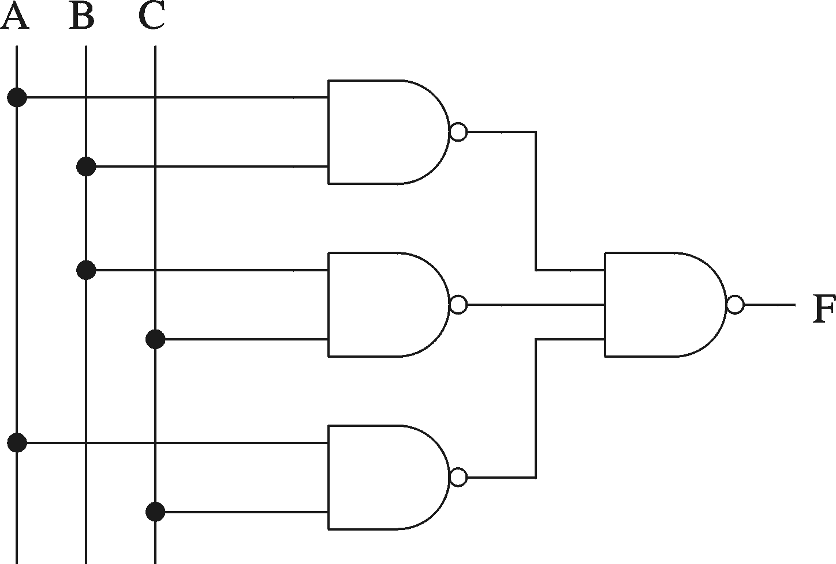
Majority Function Using Other Gates (cont'd)
Majority function

Slide 16
Combinational Logic Building Blocks

Slide 17
Multiplexers
log₂n selection inputs
n inputs
1 output
multiplexer
  n binary inputs (binary input = 1-bit input)
  log₂n binary selection inputs
  1 binary output
  Function: one of n inputs is placed onto output
  Called n-to-1 multiplexer

Slide 18
2-to-1 Multiplexer
s
s
f
w
0
0
0
w
w
f
0
1
1
1
w
1
(a) Graphical symbol
(b) Truth table
w
0
s
f
w
1
(c) Sum-of-products circuit

Slide 19
4-to-1 Multiplexer
s
0
s
1
s
1
s
0
f
w
0
00
0
0
w
0
w
1
01
f
0
1
w
1
w
2
10
1
0
w
w
3
11
w
2
1
1
3
(a) Graphic symbol
(b) Truth table
s
0
w
0
s
1
w
1
f
w
2
w
3
(c) Circuit

Slide 20
Decoders
w
y
2
n
–
1
n-1
n
inputs
2
n
w
outputs
0
Enable
En
y
0
Decoder
  n binary inputs
  2^{n} binary outputs
  Function: decode encoded information
    If enable=1, one output is asserted high, the other outputs are asserted low
    If enable=0, all outputs asserted low
  Often, enable pin is not needed (i.e. the decoder is always enabled)
  Called n-to-2^{n} decoder
    Can consider n binary inputs as a single n-bit input
    Can consider 2^{n} binary outputs as a single 2^{n}-bit output
  Decoders are often used for RAM/ROM addressing

Slide 21
2-to-4 Decoder
En
w
1
w
0
y
3
y
2
y
1
y
0
w
1
y
3
1
0
0
0
0
0
1
w
y
1
0
1
0
0
1
0
0
2
1
1
0
0
1
0
0
y
1
1
1
1
1
0
0
0
En
y
0
0
-
-
0
0
0
0
(a) Truth table
(b) Graphical symbol
w
0
y
0
w
1
y
1
y
2
y
3
En
(c) Logic circuit

Slide 22
Demultiplexers
log₂n selection inputs
1 input
n outputs
Demultiplexer
  1 binary input
  n binary outputs
  log₂n binary selection inputs
  Function: places input onto one of n outputs, with the remaining outputs asserted low
  Called 1-to-n demultiplexer
Closely related to decoder
  Can build 1-to-n demultiplexer from log₂n-to-n decoder by using the decoder's enable signal as the demultiplexer's input signal, and using decoder's input signals as the demultiplexer's selection input signals.

Slide 23
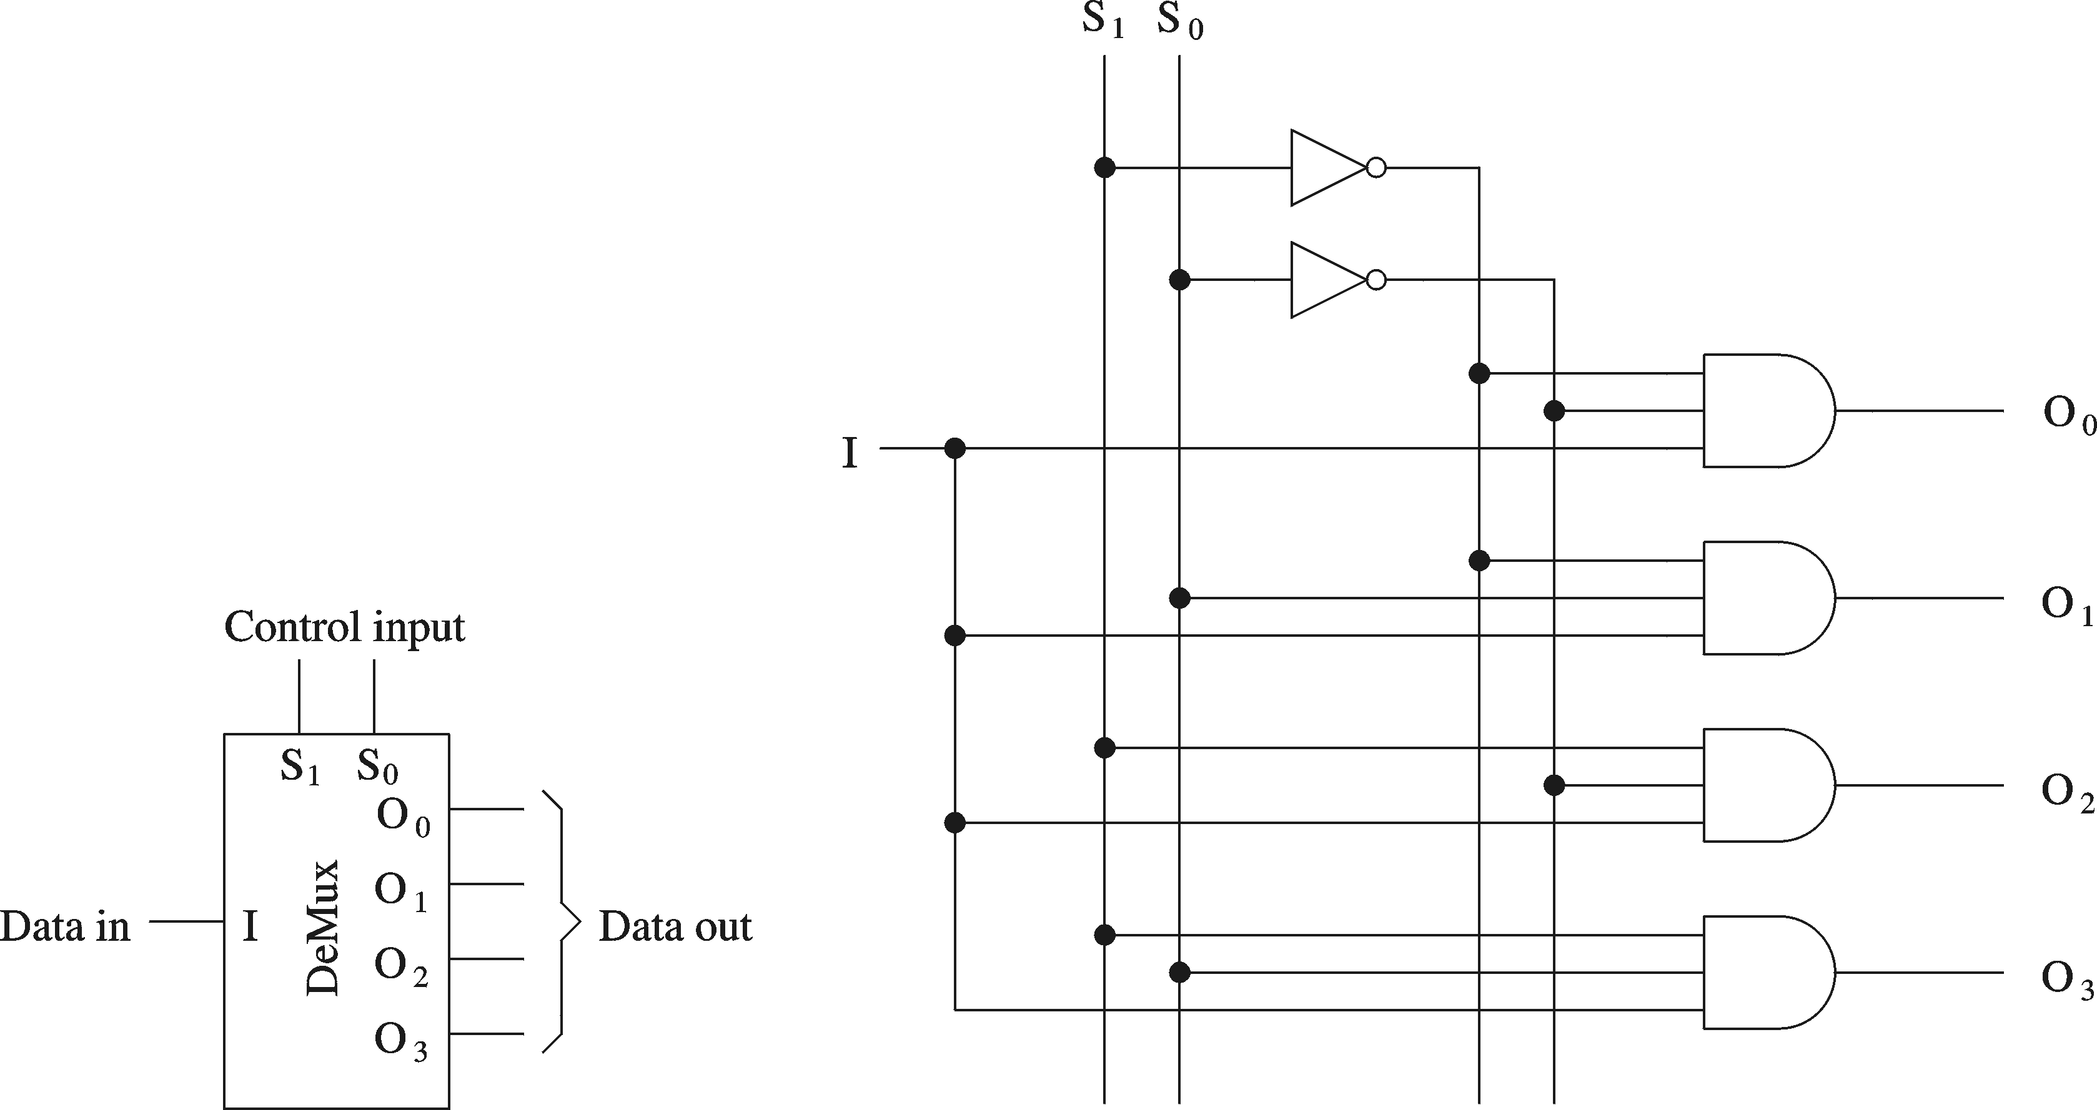
1-to-4 Demultiplexer

Slide 24
Encoders
w
2
n
–
1
y
n
–
1
2
n
n
inputs
outputs
y
0
w
0
Encoder
  2^{n} binary inputs
  n binary outputs
  Function: encodes information into an n-bit code
  Called 2^{n}-to-n encoder
    Can consider 2^{n} binary inputs as a single 2^{n}-bit input
    Can consider n binary output as a single n-bit output
Encoders only work when exactly one binary input is equal to 1

Slide 25
4-to-2 Encoder
w
3
w
2
w
1
w
0
y
1
y
0
0
0
0
1
0
0
0
0
1
0
0
1
0
1
0
0
1
0
1
0
0
0
1
1
(a) Truth table
w
0
w
1
y
0
w
2
w
y
1
3
(b) Circuit

Slide 26
Single-Bit Adders
Half-adder
  Adds two binary (i.e. 1-bit) inputs A and B
    Produces a sum and carryout
  Problem: Cannot use it alone to build larger adders
Full-adder
  Adds three binary (i.e. 1-bit) inputs A, B, and carryin
    Like half-adder, produces a sum and carryout
  Allows building M-bit adders (M > 1)
    Simple technique
      Connect C_{out} of one adder to C_{in} of the next
    These are called ripple-carry adders
    Shown in next section

Slide 27
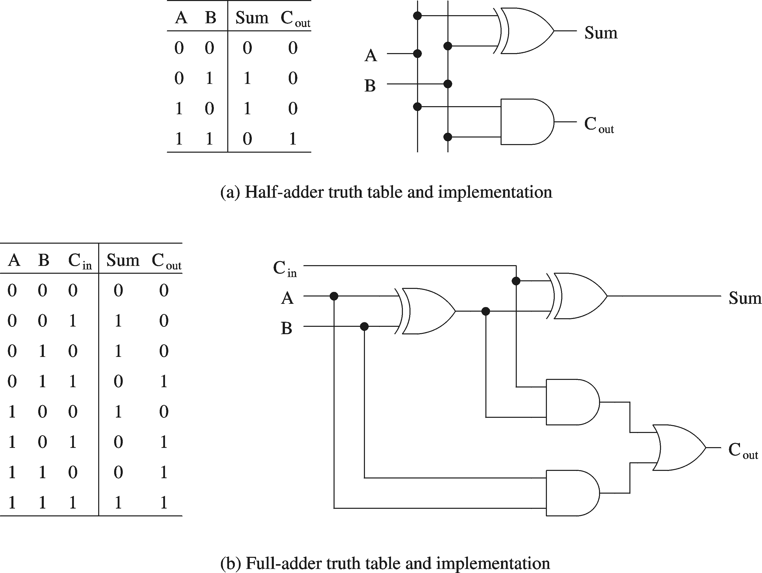
Single-Bit Adders (cont’d)

Slide 28
Multi-Bit Combinational Logic Building Blocks

Slide 29
Multi-bit 4-to-1 Multiplexer
s
0
s
1
s
1
s
0
f
w
0
00
0
0
w
0
w
1
01
f
0
1
w
1
w
2
10
1
0
w
w
3
11
8
w
2
1
1
3
8
(a) Graphic symbol
(b) Truth table
When drawing schematics, can draw multi-bit multiplexers
Example: 4-to-1 (8 bit) multiplexer
  4 inputs (each 8 bits)
  1 output (8 bits)
  2 selection bits
Can also have multi-bit 2-to-1 muxes, 16-to-1 muxes, etc.

Slide 30
4-to-1 (8-bit) Multiplexer
s
0
s
1
w₀(7)
00
w₁(7)
01
w₂(7)
10
f(7)
w₃(7)
11
A 4-to-1 (8-bit) multiplexer is composed
of eight 4-to-1 (1-bit) multiplexers
s
0
s
0
s
1
s
1
w₀(6)
w
w₁(6)
00
w
0
00
=
01
f(6)
1
01
f
w₂(6)
10
w
2
10
w₃(6)
11
w
3
11
8
8
s
0
s
1
w₀(0)
00
w₁(0)
01
w₂(0)
10
f(0)
w₃(0)
11

Slide 31
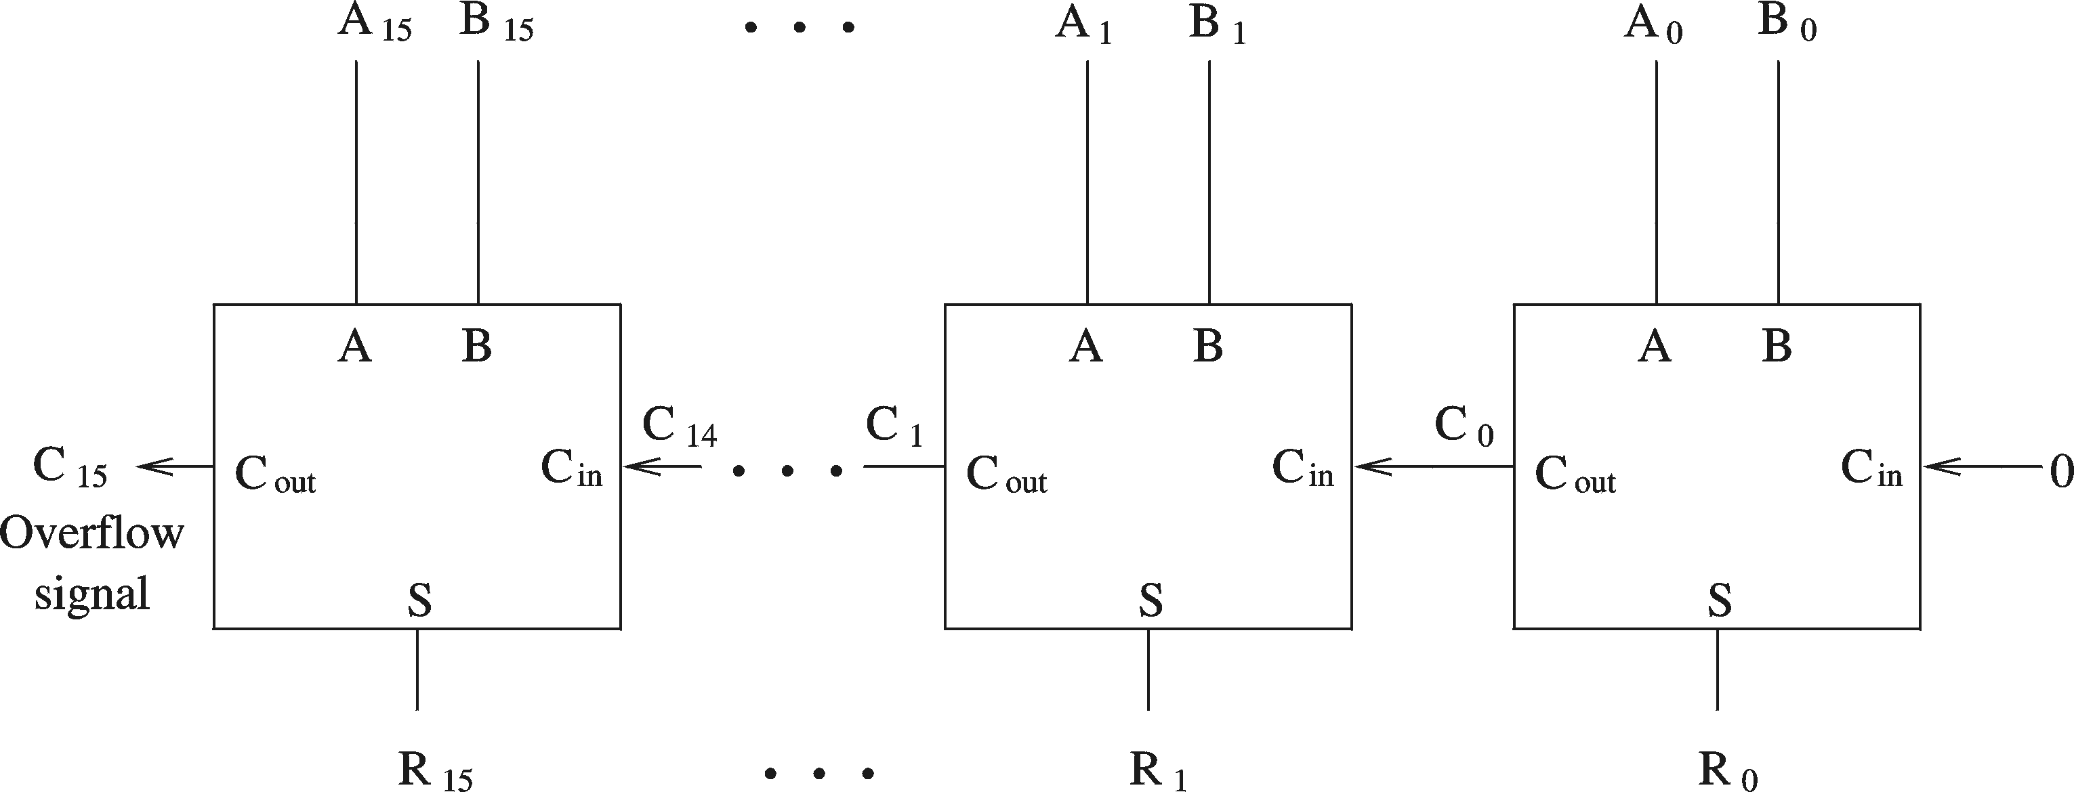
Multi-Bit Ripple-Carry Adder
A 16-bit ripple-carry adder is composed of 16 (1-bit) full adders
Inputs: 16-bit A, 16-bit B, 1-bit carryin (set to zero in the figure below)
Outputs: 16-bit sum R, 1-bit overflow
Other multi-bit adder structures can be studied in ECE 645—Computer Arithmetic
Called a ripple-carry adder because carry ripples from one full-adder to the next.
Critical path is 16 full-adders.

Slide 32
Comparator
Used two compare two M-bit numbers and produce a flag (M >1)
  Inputs: M-bit input A, M-bit input B
  Output: 1-bit output flag
    1 indicates condition is met
    0 indicates condition is not met
  Can compare: >, >=, <, <=, =, etc.
A
A > B?
M
1 if A > B
0 if A <= B
B
M

Slide 33
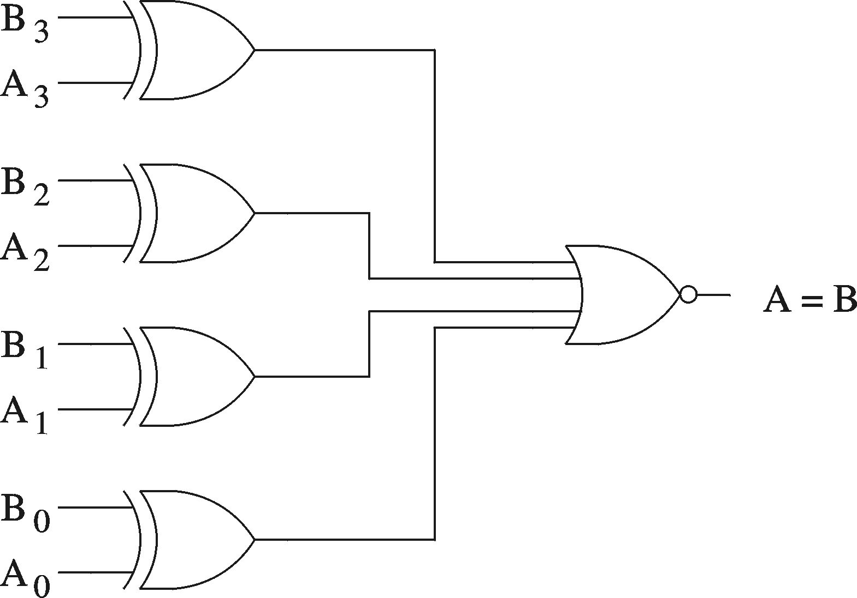
Example: 4-bit comparator (A = B)
A
A = B?
4
1 if A = B
0 if A != B
B
4

Slide 34
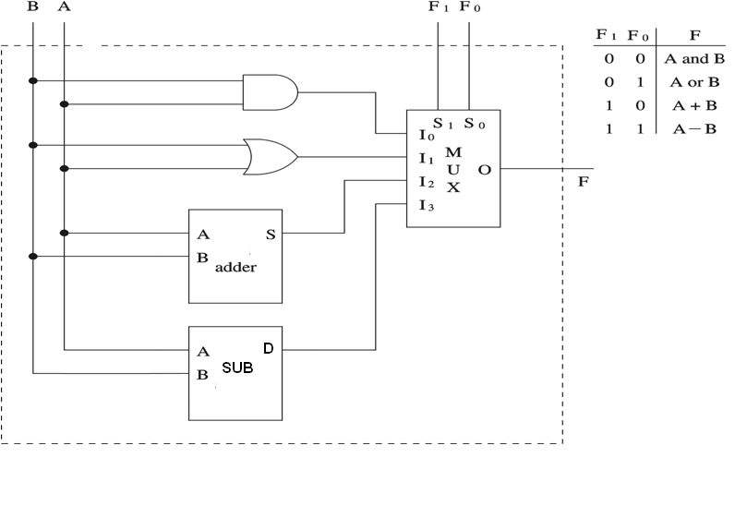
Combinational Logic Example: ALU (1-bit)
Preliminary ALU design (ALU = arithmetic + logic unit)

